Slide 1
Complex Palindrome and Permutations.
Corentin (Corey) Rejaud

Slide 2
Introduction: Complex Palindrome
Find all palindromes from all permutations of all substrings of a string ‘S’.
Runtime: O(N^2*N!)
C++11
Sequential
Parallelized

Slide 3
Introduction: Complex Palindrome …. continued
2 parts:
1) Get all substrings of string s
2) Find all palimndromes of all anagrams of each substring
Get frequency of each character in substring
Detect if it can even hold a palindrome
If it can, then call recursive function (essentially finding permutations)

Slide 4
Introduction: Permutations
The boiled down version of the Complex Palindrome question. Simpler to see speedup.
4 Parts:
Sequential Iterative algorithm
Sequential Recursive algorithm
Parallelized Iterative algorithm
Parallelized Recursive algorithm

Slide 5
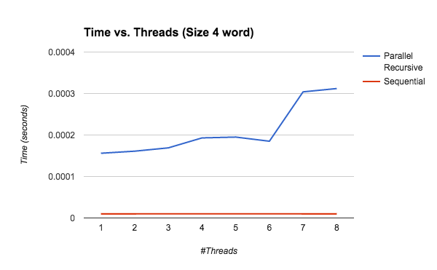
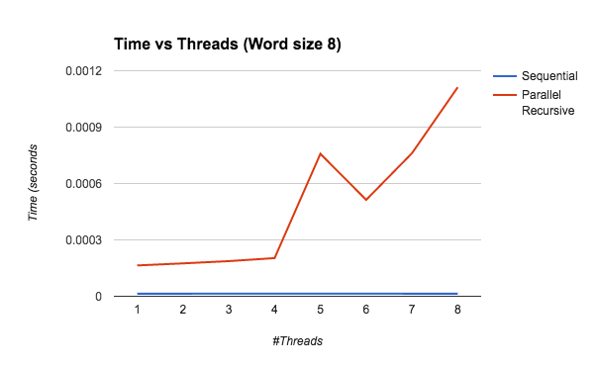
Results: Complex Palindrome | Substring part

Slide 6
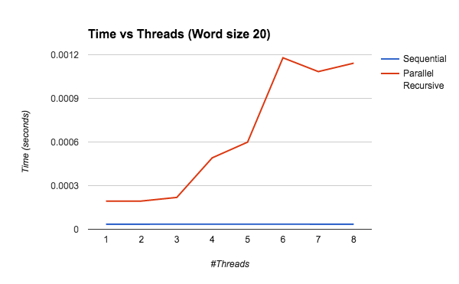
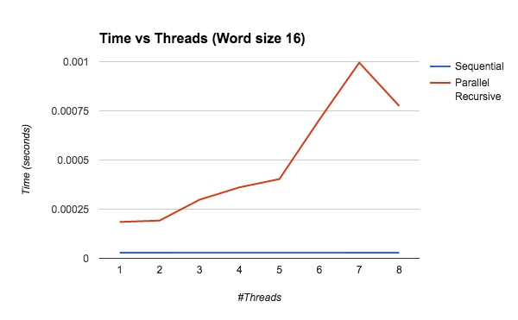
Results: Complex Palindrome | Substring part

Slide 7
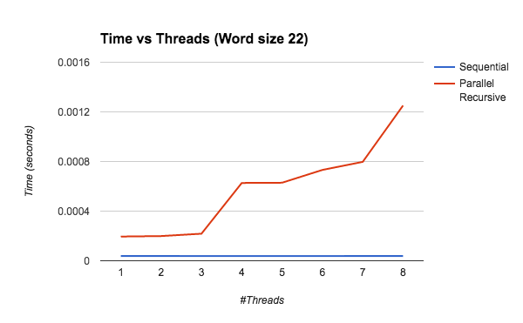
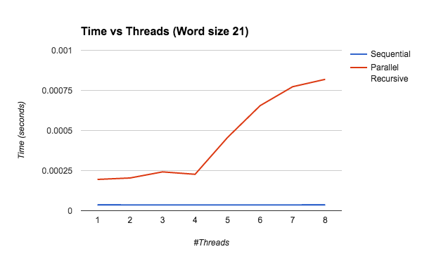
Results: Complex Palindrome | Substring part

Slide 8
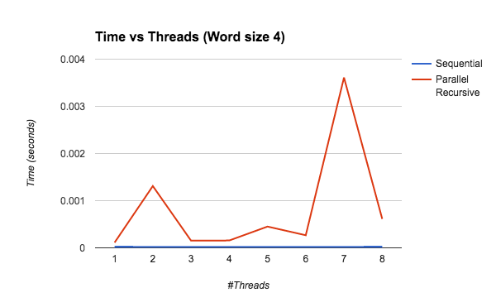
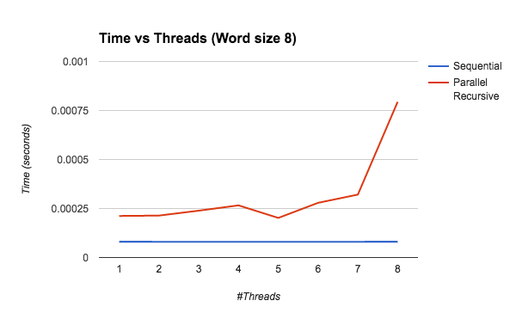
Results: Complex Palindrome | Palindrome part

Slide 9
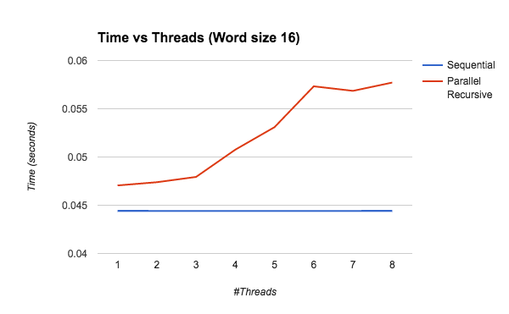
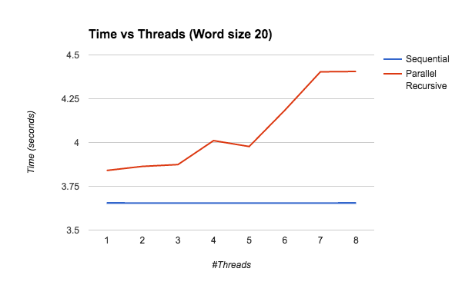
Results: Complex Palindrome | Palindrome part

Slide 10
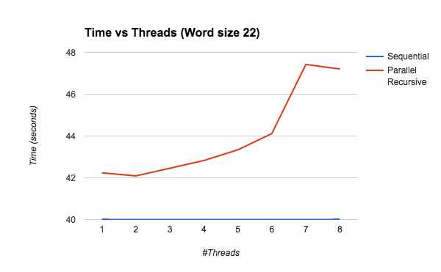
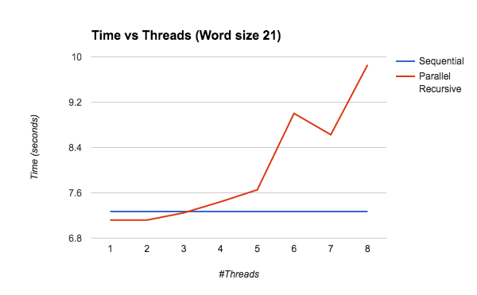
Results: Complex Palindrome | Palindrome part

Slide 11
Conclusion: Complex Palindrome
Need to go deeper and solve the permutation problem
Note: word length of complex palindrome problem is 2x larger of the permutation problem (but don’t worry, that’s normal)
Note: The complex palindrome problem does the permutation problem for half of its word size, so the two algorithms should be comparable in run-time

Slide 12
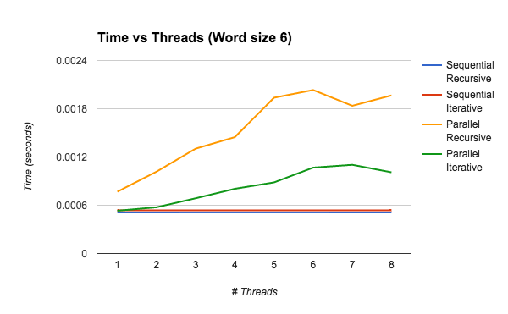
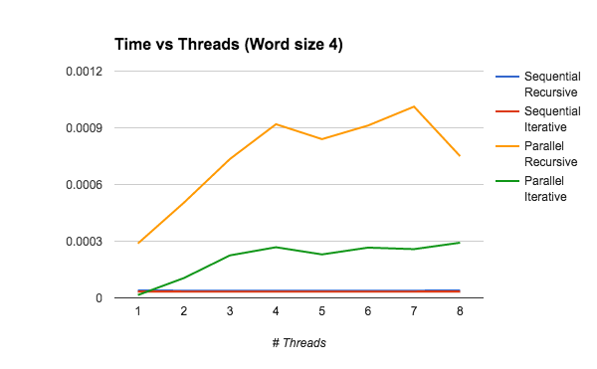
Results: Permutation

Slide 13
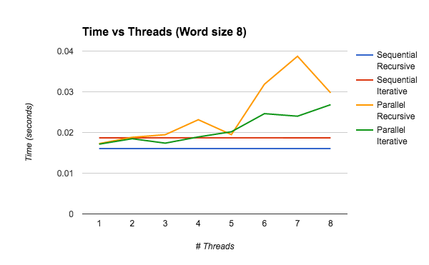
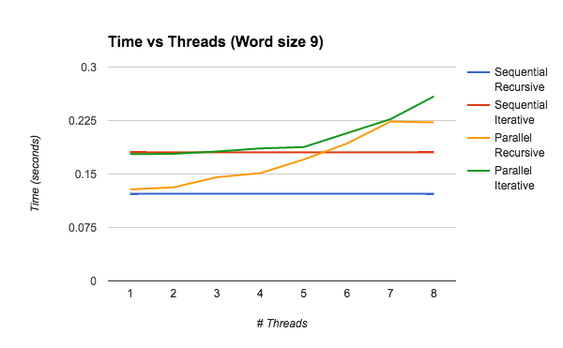
Results: Permutation

Slide 14
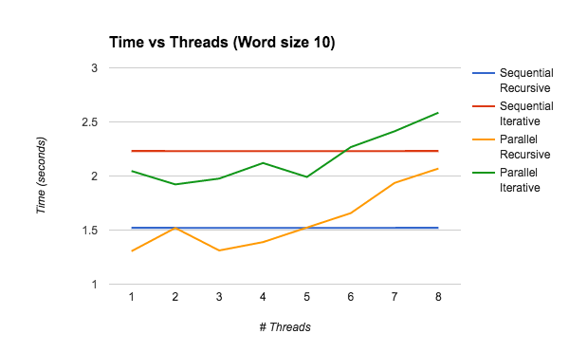
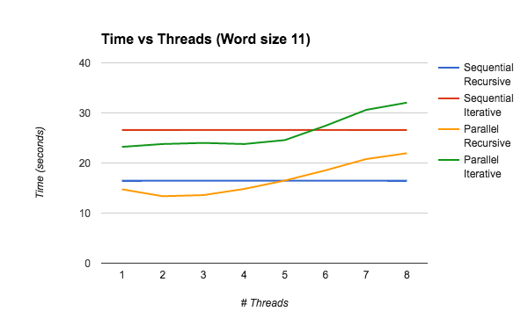
Results: Permutation

Slide 15
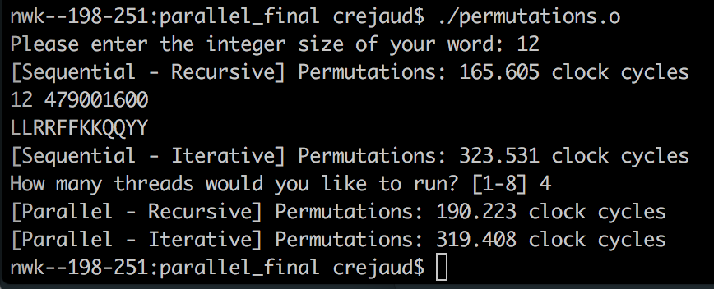
Results: Permutation - Par. Iterative > Seq. Iterative

Slide 16
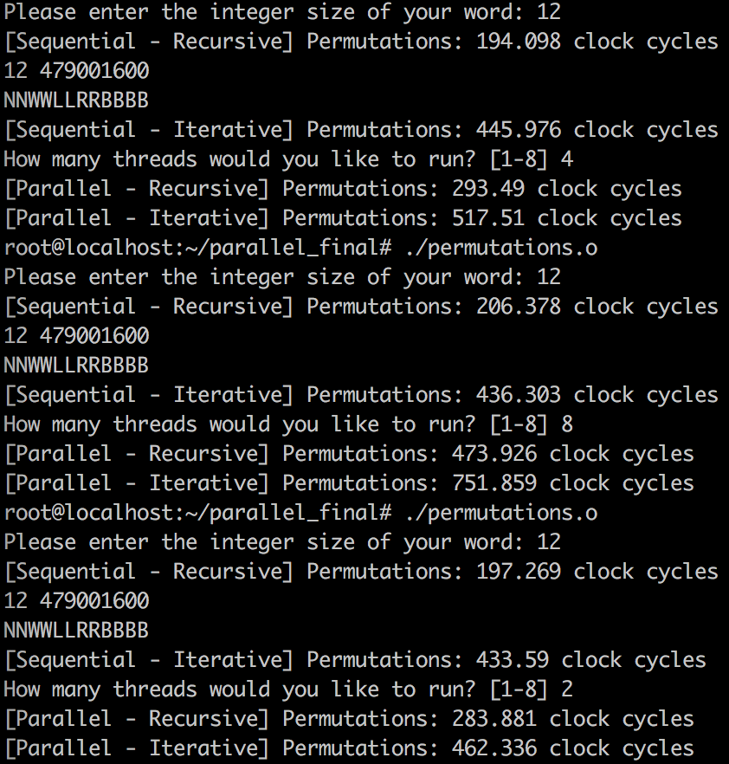
Orbit
i7 speeds:

Slide 17
We need to go deeper → ISPC
I wrote an ISPC version to try to achieve speedup for permutations.
Ran on MBP (i7 Quad Core 2.5ghz 5th gen)
Ran on Sandbox 1 Node 2-1 (12-core 3.33ghz)

Slide 18
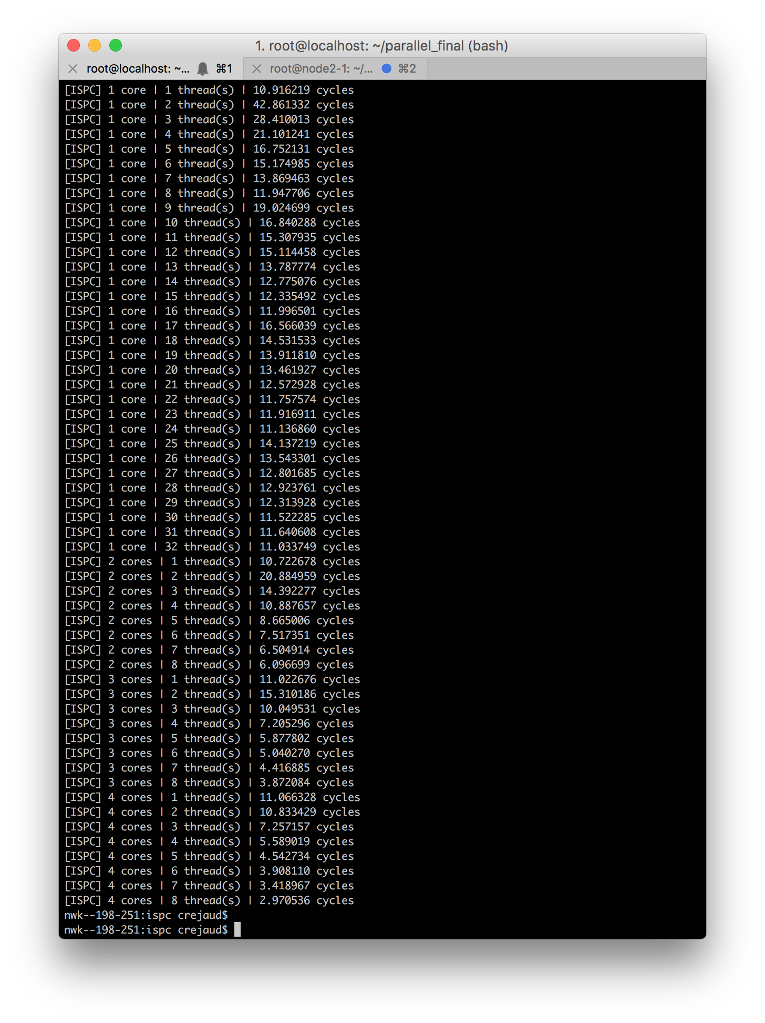
MBP
Sequential Recursion speed:
16.4664

Slide 19
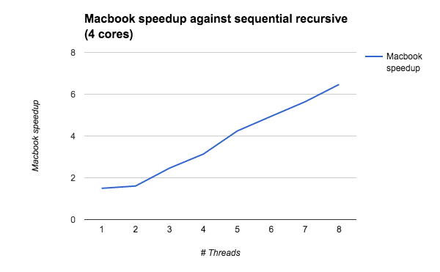
MBP 4 cores speedup vs Seq

Slide 20
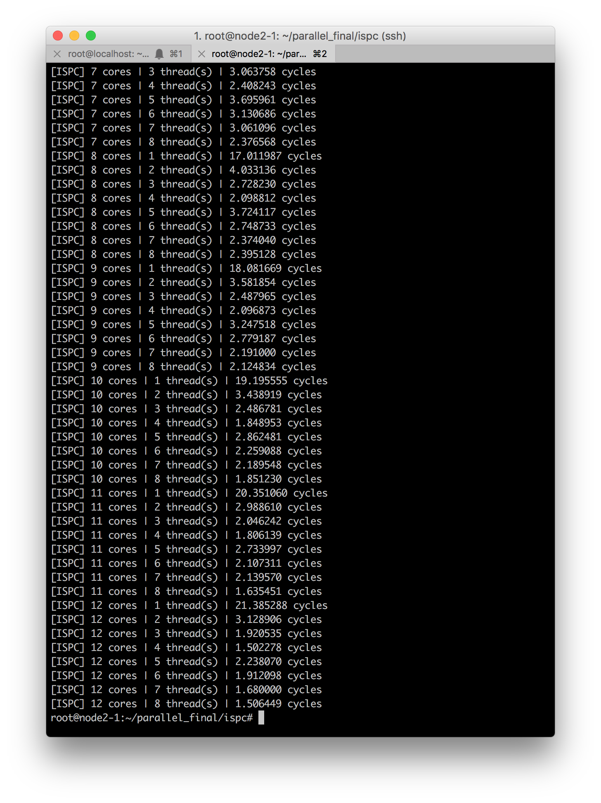
Orbit Sandbox 1
Sequential Recursion speed:
23.2057

Slide 21
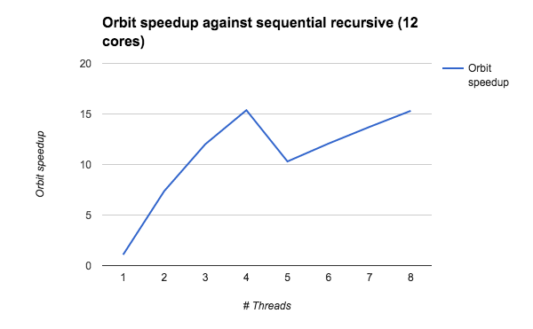
Orbit 12 cores speedup vs Seq

Slide 22
Demo!

